Slide 1
Tensorflow & keras
How to implement neural networks

Slide 2


Slide 3


Slide 4


Slide 5

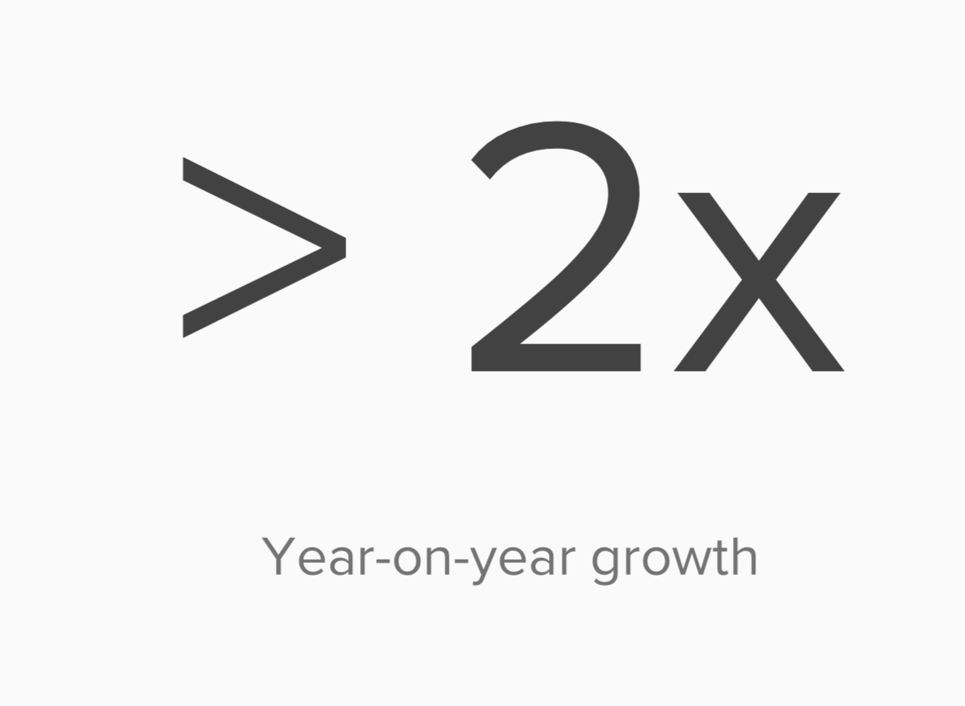

Slide 6
What is a tensor?
A vector is a 1-D
A matrix is mxn
A tensor is often thought of as a generalized matrix.
It could be a 1-D matrix (a vector is actually such a tensor)
It could be a 3-D matrix (something like a cube of numbers)
even a 0-D matrix (a single number)
or a higher dimensional structure that is harder to visualize.
The dimension of the tensor is called its rank.

Slide 7
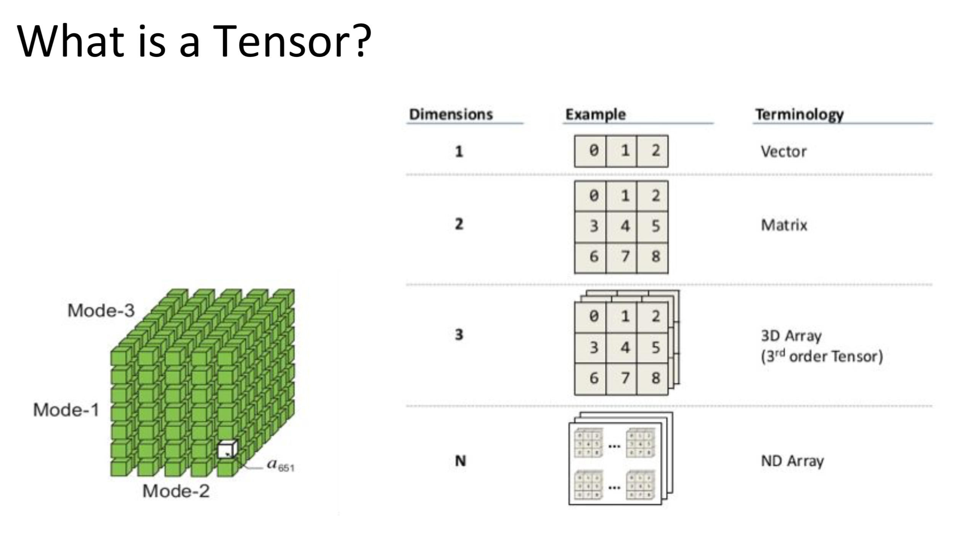

Slide 8
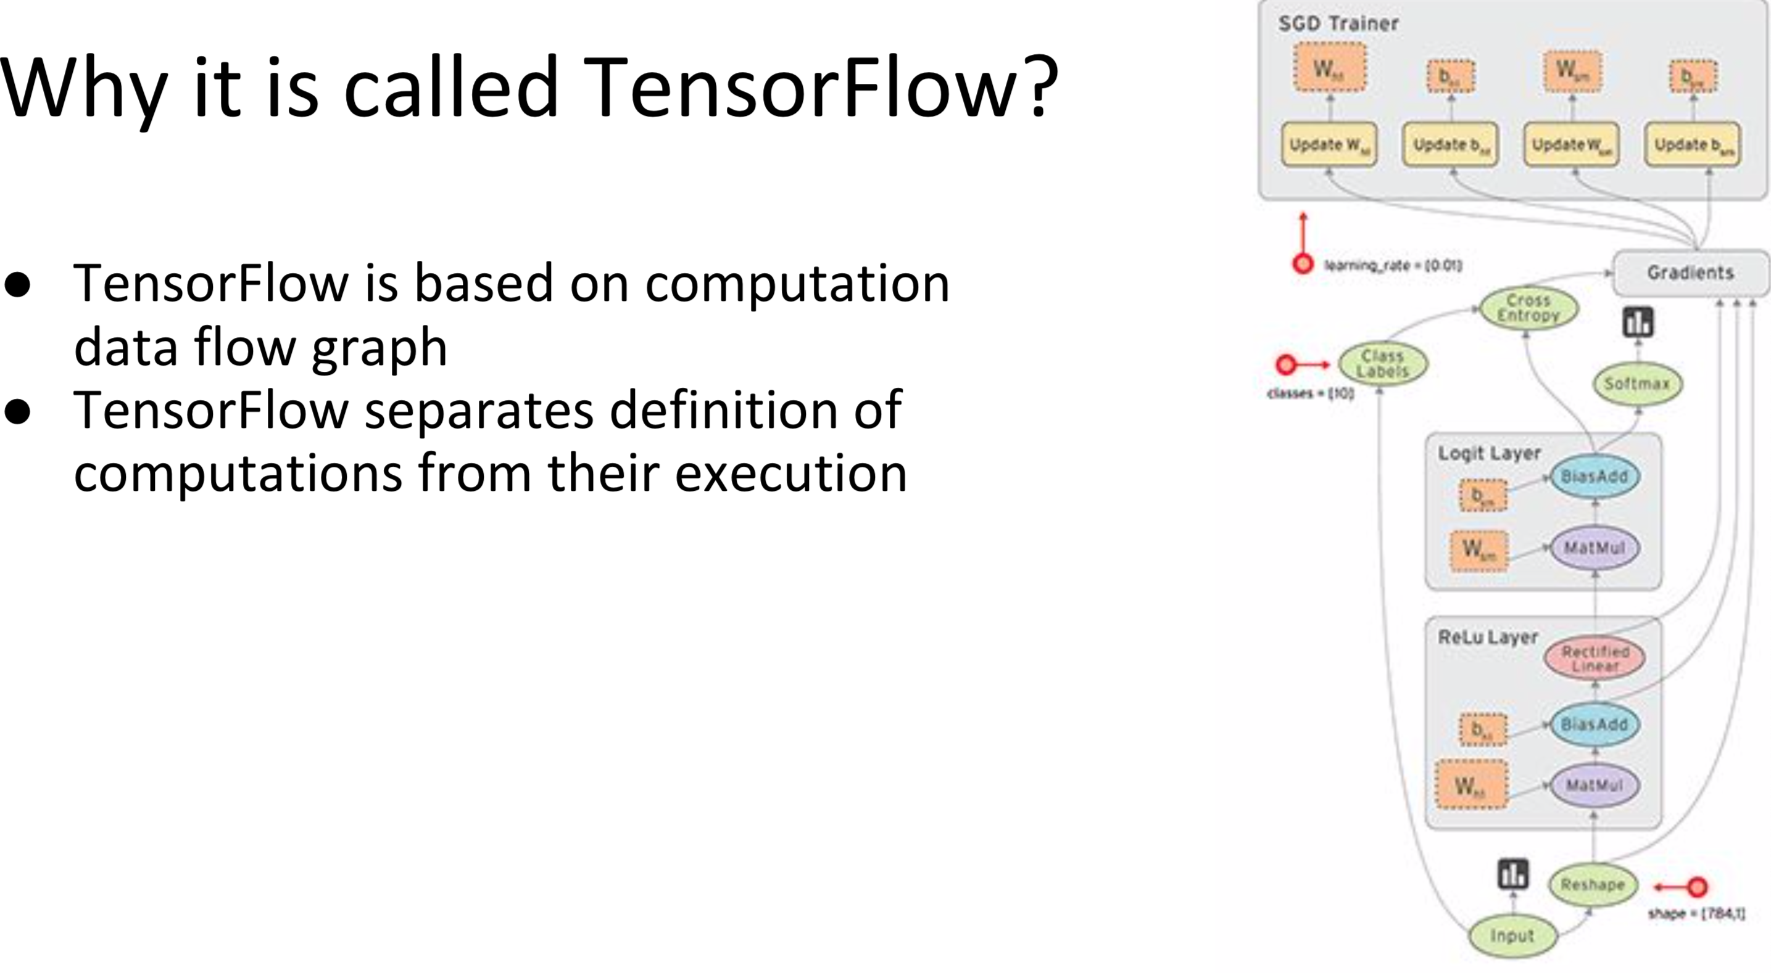

Slide 9

Tensorflow installation
pip3 install tensorflow
OR
Anaconda: conda install -c conda-forge tensorflow

Slide 10
Keras
https://keras.io/
Minimalist, highly modular neural
networks library
Written in Python
Capable of running on top of either TensorFlow/Theano and CNTK
Developed with a focus on enabling fast experimentation

Slide 11
Keras (Cont.)
Modularity
A model is understood as a sequence or a graph of standalone, fully-configurable modules that can be plugged together with as little restrictions as possible
Minimalism
Each module should be kept short and simple
Easy extensibility
New modules can be easily added and extended

Slide 12
The Design
General idea is to based on layers and their input/output
Prepare your inputs and output tensors
Create first layer to handle input tensor
Create output layer to handle targets
Build virtually any model you like in bet

Slide 13
Installation
pip3 install keras

Slide 14
